Slide 1
Web Services for Genre Vocabularies
Diane Vizine-Goetz
Eric Childress
Andrew Houghton
DC-2005 Vocabularies in Practice
14 September 2005
Madrid, Spain
Presented by
Eric Childress

Slide 2
Outline
OCLC Terminologies Services Research Project
Prototype Terminology Pane application

Slide 3
OCLC Research
Terminology Services Project
Goals:
  Provide instances of Web services-accessible controlled vocabularies and other knowledge organization schemes (KOS)
  Develop prototype terminology services that can be accessed by library and Semantic Web applications
Notes:
Web services are modular, web-based, machine-to-machine applications that can be combined in various ways.

Slide 4
Initial focus on genre vocabularies
Available vocabularies:
  DCMI Type Vocabulary
    Dublin Core Metadata Initiative
  Genre Terms For Fiction And Drama (GSAFD)
    American Library Association
  Newspaper Genre Terms (NGL)
    ALCTS Newspaper Discussion Group
Under development:
  Radio Form/Genre Terms (RADFG)
    U.S. Library of Congress
  Moving Image Form/Genre Terms (MIGFG)
    U.S. Library of Congress
  Répertoire de vedettes-matière (RVM)
    Bibliothèque de l'Université Laval
Notes:
See http://www.oclc.org/research/projects/termservices/resources/tspilot-services.htm for a list of available vocabularies
Work is also underway on:
Medical Subject Headings (MeSH)
U.S. National Library of Medicine 2005 MeSH & 2005 MeSH sample

Slide 5



1. Preparing a terminology file
schema
transformation
data
enhancement
Conversion from most
formats:
Z39.19
wordlists in PDF, etc.
Vocabulary X
Add:
provenance (MARC Org. Codes)
persistent identifiers (info:kos)
Initial conversion to
MARC XML
Authorities format, or,
Classification format
Optionally, add:
inter-vocabulary mappings
  Concepts & terms
Vocabulary Y
Zthes
SKOS
Notes:
Convert files to standard format:
MARC 21 authorities or classification formats
Enhance records with administrative data
As feasible, enrich with mappings to other vocabularies
Rendering of files into multiple formats (MARC XML, Zthes, SKOS)
Load into services environment:
Supports various web services

Slide 6
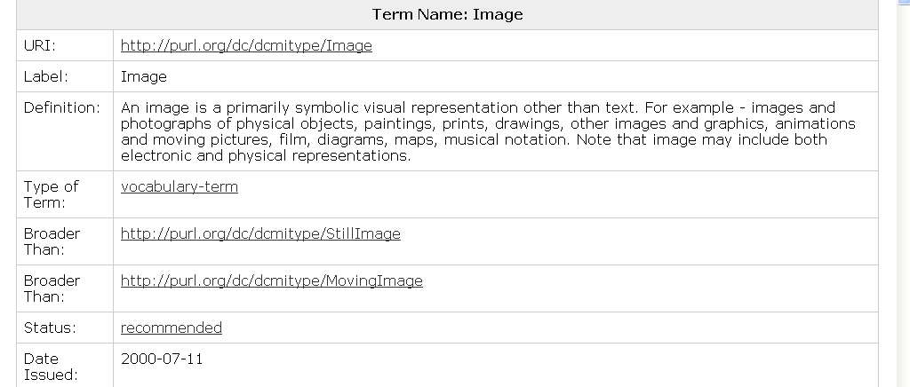
Sample source file: DCMI Type vocabulary
PREFERRED TERM
HTML display of DCMI type vocabulary
Notes:
HTML and RDF versions are not identical

Slide 7
MARC-XML encoding of DCMI Type
Excerpt from record for “Image”
      <datafield tag="040" ind1="" ind2="">
        <subfield code="a">OhDuDCMI</subfield>
        <subfield code="b">eng</subfield>
        <subfield code="c">OCoLC-O</subfield>
        <subfield code="d">OCoLC-O</subfield>
        <subfield code="f">dct</subfield>
      </datafield>
      <datafield tag="155" ind1="" ind2="">
        <subfield code="a">Image</subfield>
      </datafield>
      <datafield tag="555" ind1="" ind2="">
        <subfield code="w">h</subfield>
        <subfield code="a">Still Image</subfield>
      </datafield>
PREFERRED TERM
Notes:
MARC 21 Format for Authority Data. MARC 21 was chosen for the project because it includes mechanisms for coding common controlled vocabulary elements, such as preferred and non-preferred terms, term relationships, term mappings, and the source of the content and origin of changes

Slide 8
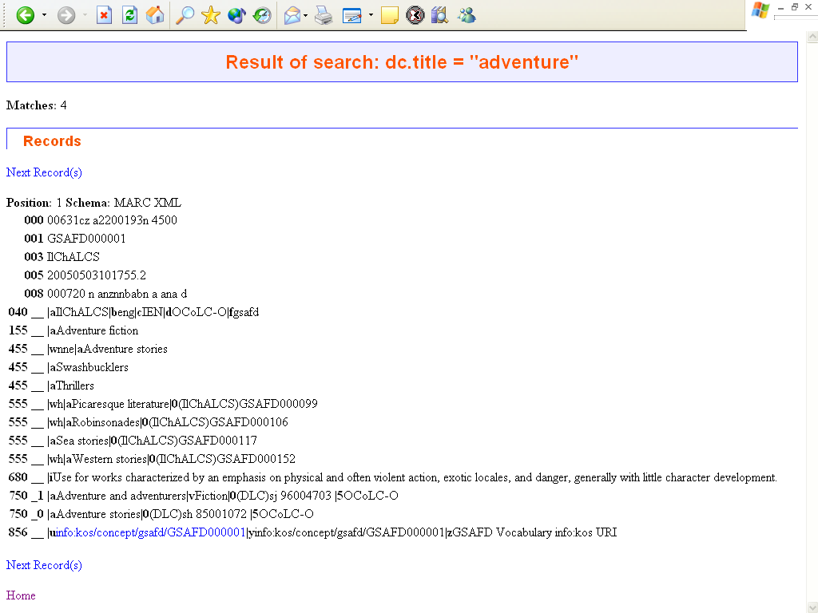
Sample source file: GSAFD
(Guidelines on Subject Access to Individual Works of Fiction, Drama, Etc., )
PREFERRED TERM
MAPPED TERMS
GSAFD record in MARC 21 authorities format as retrieved from an SRW server at OCLC
Notes:
This shows a display of a GSAFD record in MARC 21 authorities format as retrieved from an SRW server at OCLC
GASFD= Guidelines on Subject Access to Individual Works of Fiction, Drama, Etc.,
Terminology services that support search and retrieval might use the full range of available mappings, while services invoked during indexing or cataloging might use only mappings produced by a specific organization or for a given vocabulary.
Indicators
First - Undefined
# - Undefined
Second - Thesaurus
The thesaurus or authority file from which the heading came.
0 - Library of Congress Subject Headings/Name authority file
1 - LC subject headings for children's literature
2 - Medical Subject Headings/NLM name authority file
3 - National Agricultural Library subject authority file
4 - Source not specified
5 - Canadian Subject Headings/LAC name authority file
6 - Répertoire de vedettes-matière
7 - Source specified in subfield $2
$0 - Record control number (R) See Control Subfields
$2 - Source of heading or term (NR) See Heading Linking Entries--General Information
$5 - Institution to which field applies (R) See Control Subfields

Slide 9
2. Publishing files to the Web
Support for searching:
  Web services including:
    SRU/W
    Microsoft Research Pane application
  HTML search interface

Slide 10
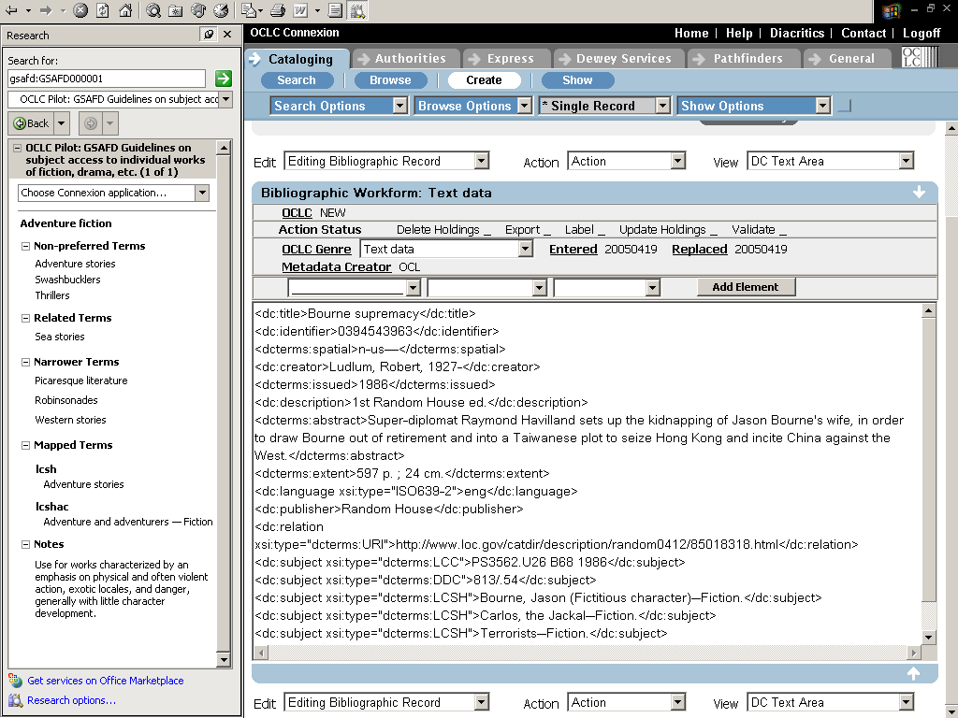
Full Text
Database
SQL
XML
Terminology
Services
Architecture
Vocabulary A
Vocabulary B
Vocabulary C
SRW/U
REST
SOAP
1
Web
Service
2
Microsoft Office Research Pane
Registration
Query handling
Markup translation
Authorization/Authentication
3
Terminology
Pane
Metadata Editing Application
Notes:
The implementation of Web services support in several widely-adopted platforms and applications presents an opportunity to offer terminology Web services in a variety of modular arrangements. OCLC Research is making a set of services for genre vocabularies available on an experimental basis. Services are provided through the MS Office Research pane, a built-in feature of Internet Explorer when users have loaded MS Office 2003.
Vocabularies can be stored as full text databases, SQL databases or XML files, and can be accessed with SRW/U, REST or SOAP based interfaces. Using MARC XML as input, OCLC’s experimental implementation uses the OCLC Pears full text database software along with an SRW Web service interface to access the vocabularies. The terminology Web service acts as a proxy to the vocabularies providing query and markup translation along with authentication and authorization, when necessary.
The Microsoft Research pane, item one (lower right), provides a service oriented architecture (SOA) framework for accessing terminology services. SOA is an approach to distributed computing where services are loosely coupled and discoverable on the network.
Microsoft has defined a public schema, known as Research Services, for interaction with the Research pane client.
The Research Services Web service (Query translation) is used as a proxy to any backend storage technology containing controlled vocabularies. The diagram depicts access to various backend storage technologies through distributed Web service protocol technologies such as SRW/U, REST and SOAP. Our architecture insulates access to the various backend storage technologies because the controlled vocabularies may not reside at OCLC. However, the Web service (Query translation) could have accessed those backend storage technologies directly and/or use the distributed Web service protocol technologies.

Slide 11
Microsoft Research Pane
Part of MS Office 2003 installation
Provides a convenient means for users of Internet Explorer and MS Office 2003 applications to have access to loosely-coupled services from 3rd parties…
  Examples:
    Access to 3rd party reference databases (e.g., articles)
    Access to special files like thesauri

Slide 12
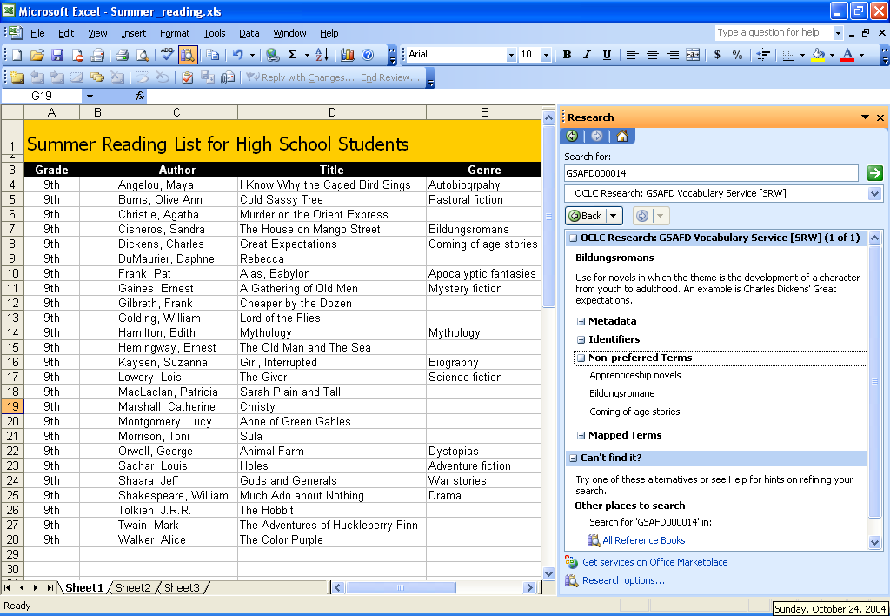

Slide 13
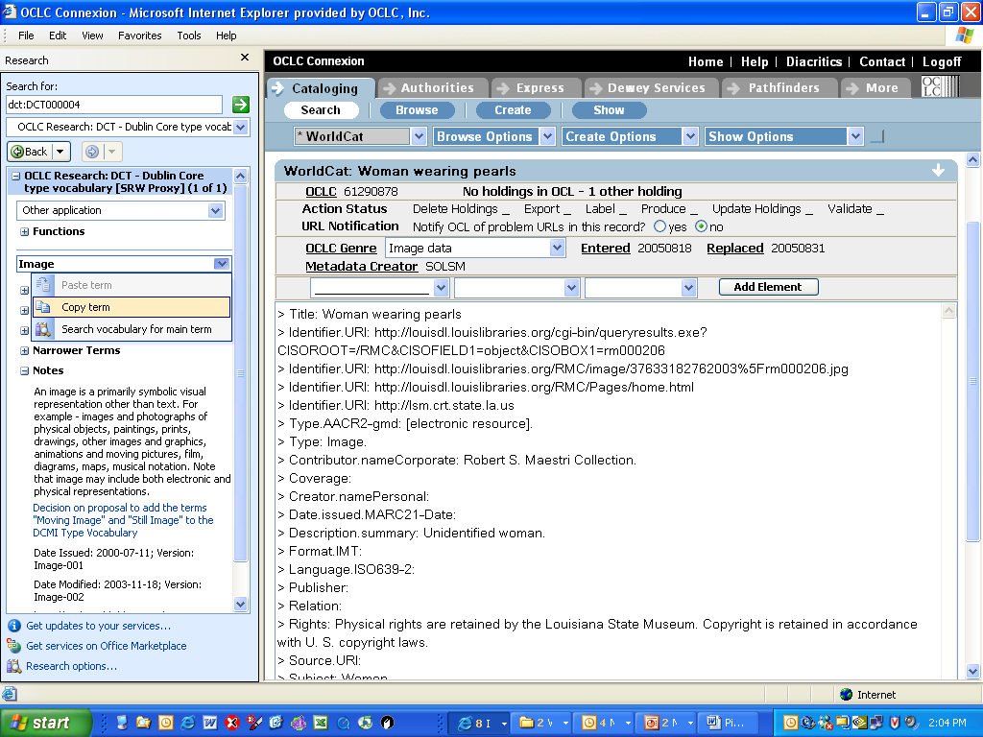
Notes:
As a side-bar application, the MS Office Research Pane provides users the ability to conveniently interact with remote databases without interrupting their interaction with their main application (e.g., a metadata editing application in the main window in IE). Information retrieved in the Research Pane (e.g., a genre term) can be easily transferred into the main application

Slide 14
Links
OCLC Research
  http://www.oclc.org/research/
ResearchWorks
  http://www.oclc.org/research/researchworks/
Terminology Services project
  http://www.oclc.org/research/projects/termservices/
OCLC Terminologies Pilot
  http://www.oclc.org/research/projects/termservices/resources/tspilot-services.htm

